Slide 1





LITD- SM Department
BUREAU OF INDIAN STANDARDS
Smart Manufacturing in India: Empowering MSMEs for Future Growth
Presentation By :
- Soham Wankar - Sai Kiran Varma
B.Tech Smart Manufacturing , IIITDM Jabalpur

Slide 2
INTRODUCTION
MSME stands for Micro, Small, and Medium Enterprises. It is a classification used by governments and organizations to categorize businesses based on their size and annual turnover or investment.
Manufacturing Enterprises:
Involved in production or manufacturing of goods listed in 1st schedule to Industries (Development and Regulation) Act, 1951.
Utilize plant and machinery to enhance the value, uniqueness, or purpose of the final product.
Classification based on investment in Plant & Machinery.
Service Enterprises:
Offer a range of services.
Defined by the level of investment in equipment.

Slide 3
SIGNIFICANCE OF MSMEs
Economic Backbone:
Acknowledged as the backbone of the Indian economy.
Contribute around 30% of India's GDP as of FY2023.
Key drivers of employment, exports, and credit market.
Registration and Numbers:
Over 13.8 million micro-enterprises, 3% small enterprises, and 0.28% medium enterprises registered on the Udyam portal.
Industry Dominance:
Comprise more than 95% of industries in India.
Generate over 45% of total manufacturing output.
Employ more than 40% of the workforce.
5. Market Size:
As of Feb 2023, 14.4 million MSMEs registered on Udyam portal.
Micro-enterprises: 96.12%, Small enterprises: 3.11%, Medium enterprises: 0.28%.
6. Export Potential:
MSME-related exports contribute around 42.6% of total exports in FY2023.
Slight decline from previous years (around 49%).
7. Average Loan Size:
Medium-sized enterprises secure highest average loan size (9.74 million INR).
Small enterprises follow with an average loan size of around 4.5 million INR.

Slide 4
SMART MANUFACTURING FOR MSMES
Smart Manufacturing is KEY to achieve Industry 4.0 by providing fully automated manufacturing systems using technologies like Cyber-Physical systems. IOT etc.
Transformation and Global Competitiveness: Embracing Smart Manufacturing drives India's transition to Industry 4.0, enhancing global competitiveness.
Recent Growth Trends: In April 2023, Indian manufacturing production grew by 4.90%, showcasing positive trends.
Market Projections: The Value Added in Manufacturing market is set to reach $244.50 billion in 2023, with a CAGR of 8.36%. The Industry 4.0 Market is projected to grow from $94.42 billion in 2023 to $241.58 billion by 2028, at a CAGR of 20.67%.
Significance of Manufacturing: Manufacturing contributes 78% to India's industrial output, spanning sectors like metals, chemicals, machinery, and textiles.

Slide 5
Cyber-Physical Systems (CPS):
Integration of digital and physical elements to enhance efficiency and automation.
Enables real-time monitoring, control, and optimization of processes.
Improves resource allocation, production quality, and reduces operational costs.
Internet of Things (IoT):
Interconnected devices gather and share data for better decision-making.
Enhances remote monitoring, predictive maintenance, and supply chain optimization.
Facilitates efficient resource utilization and improved customer experiences.
Artificial Intelligence (AI) and Machine Learning (ML):
AI-driven insights for data-driven decision-making.
ML algorithms analyze patterns and provide predictive insights.
Automation of tasks, enhanced personalization, and process optimization.
Big Data Analytics:
Processing and analyzing large volumes of data for insights.
Helps in identifying market trends, customer preferences, and business opportunities.
Supports informed decision-making and strategic planning.
Augmented and Virtual Reality (AR/VR):
AR/VR applications enhance training, design, and visualization.
Remote assistance and virtual product experiences improve customer engagement.
Speeds up design iterations and reduces costly physical prototypes.
Cloud and Edge Computing:
Cloud offers scalable storage and processing power.
Edge computing enables real-time data processing at the source.
Increases accessibility, flexibility, and responsiveness of IT infrastructure.
Robotics and Automation:
Automation of repetitive tasks for improved efficiency and reduced errors.
Enhanced precision and consistency in manufacturing processes.
Allows MSMEs to remain competitive by optimizing production.
Cybersecurity:
Protection of digital assets from cyber threats.
Safeguards sensitive customer data and prevents breaches.
Builds trust among customers and partners, crucial for growth.
Digital Twin:
Virtual replicas of physical products/processes for real-time monitoring.
Predictive maintenance and performance optimization.
Reduces downtime, increases productivity, and extends equipment life.
Additive Manufacturing:
3D printing technology for rapid prototyping and production.
Reduces material waste and enables complex designs.
Enhances customization and accelerates product development.

Slide 6
CHALLENGES FOR MSMES TO ADOPT SMART MANUFACTURING
Technological Constraint: Difficulty to select the most appropriate and cost-effective technologies for their specific needs.
Return on Investment (ROI) Uncertainty: MSMEs are cautious about investing in smart manufacturing technologies due to uncertainty about the ROI and the time required to realize the benefits. Convincing stakeholders about the long-term advantages can be challenging.
Resistance to Change: Traditional mindsets and resistance to organizational change can hinder the adoption of smart manufacturing technologies. Employees may fear job displacement or lack the motivation to embrace technological advancements.
Government Support and Policies: While the Indian government has introduced initiatives to promote digital transformation and smart manufacturing, MSMEs may still face difficulties in accessing relevant support and navigating complex policies

Slide 7
CASE STUDY - I
SCHNIEDER ELECTRIC SMART FACTORY
Bengaluru Smart Factory and Industry 4.0:
Schneider Electric's Bengaluru Smart Factory is a pioneer in Industry 4.0.
Employs technologies like CPS, IoT, AR, AI, Robotics, and more.
Aims to achieve efficiency, reliability, safety, and sustainability.
Transformation and Global Competitiveness:
Bengaluru Smart Factory represents Industry 4.0 in India. and Aligns with India's Industry 4.0 agenda.
Enhances global competitiveness through digital transformation.
Production and Value Added:
Bengaluru factory focuses on UPS units and Drives.
Value Added in Manufacturing projected at US$244.50 billion in 2023.
Industry 4.0 Market size to reach USD 241.58 billion by 2028.
Smart Manufacturing Technologies:
Adopts EcoStruxure for integration of physical and digital systems.
Utilizes IoT for monitoring, predictive maintenance, and real-time data.
Employs AR/VR for training, maintenance, and troubleshooting.
Implements additive manufacturing for prototypes and parts.
Benefits and Efficiency:
Enhances production efficiency, reduces cycle times, and increases output.
Cost reduction through automation and optimized processes.
Improved product quality, real-time data analysis, and defect reduction.
Sustainability Initiatives:
Schneider Electric's sustainability efforts validated by Science Based Targets.
Contributions towards reducing CO2 emissions, promoting green solutions, and energy management.
Conclusion:
Bengaluru Smart Factory exemplifies success in smart manufacturing.
Offers valuable lessons for other MSMEs.
Represents the future of Industry 4.0 and sustainable manufacturing.

Slide 8
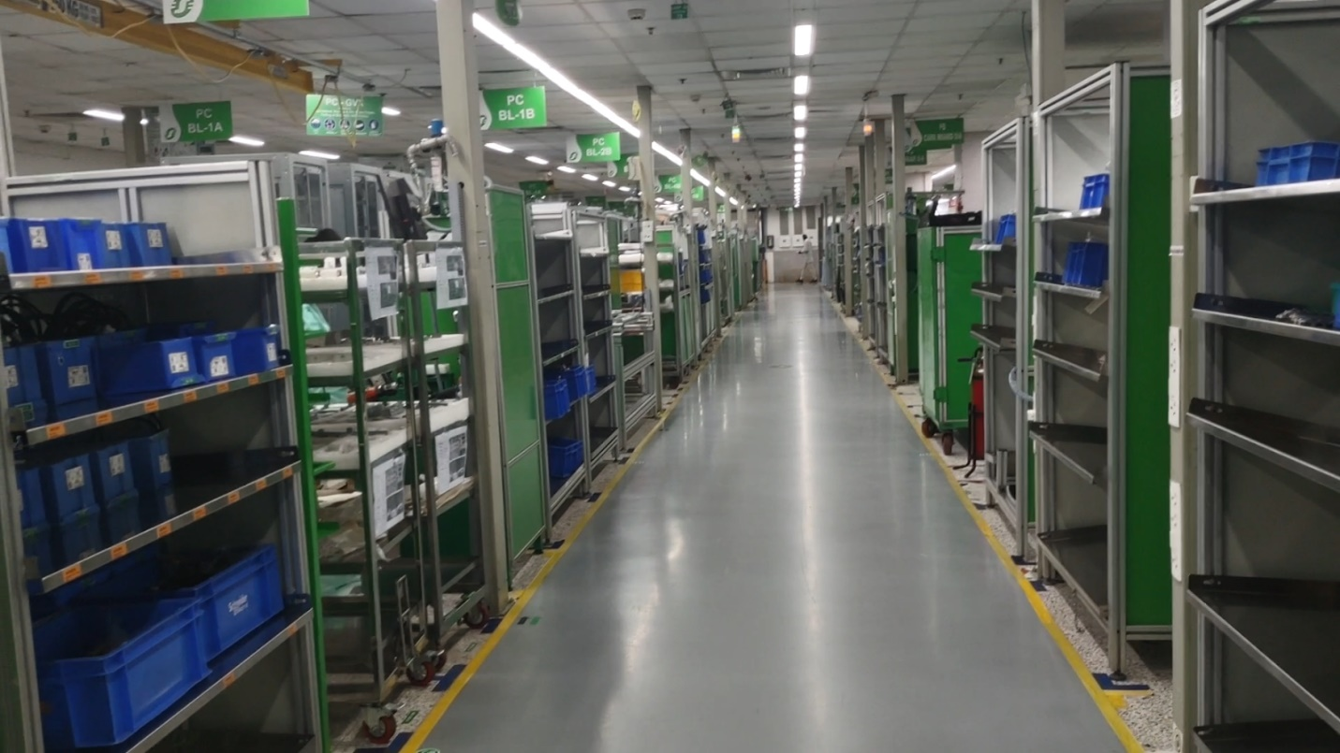
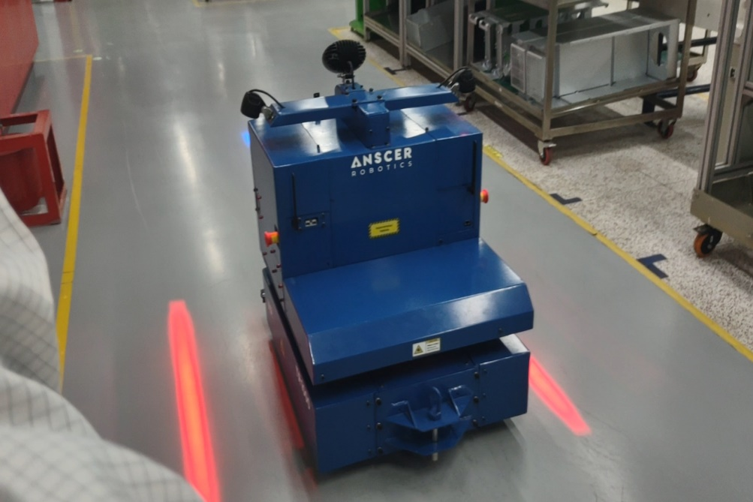
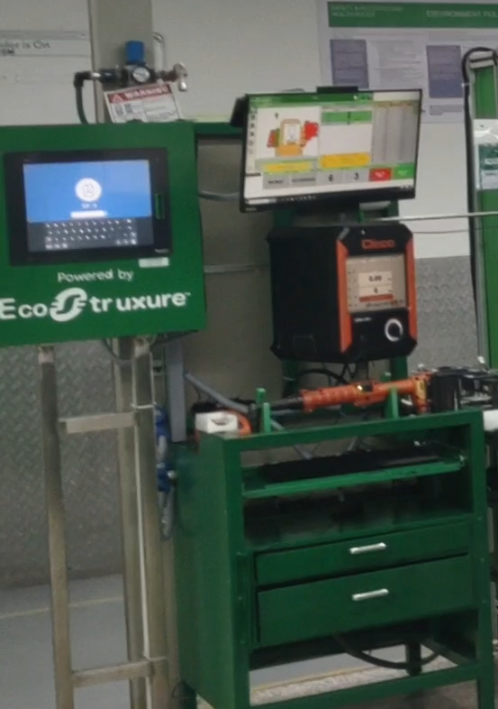
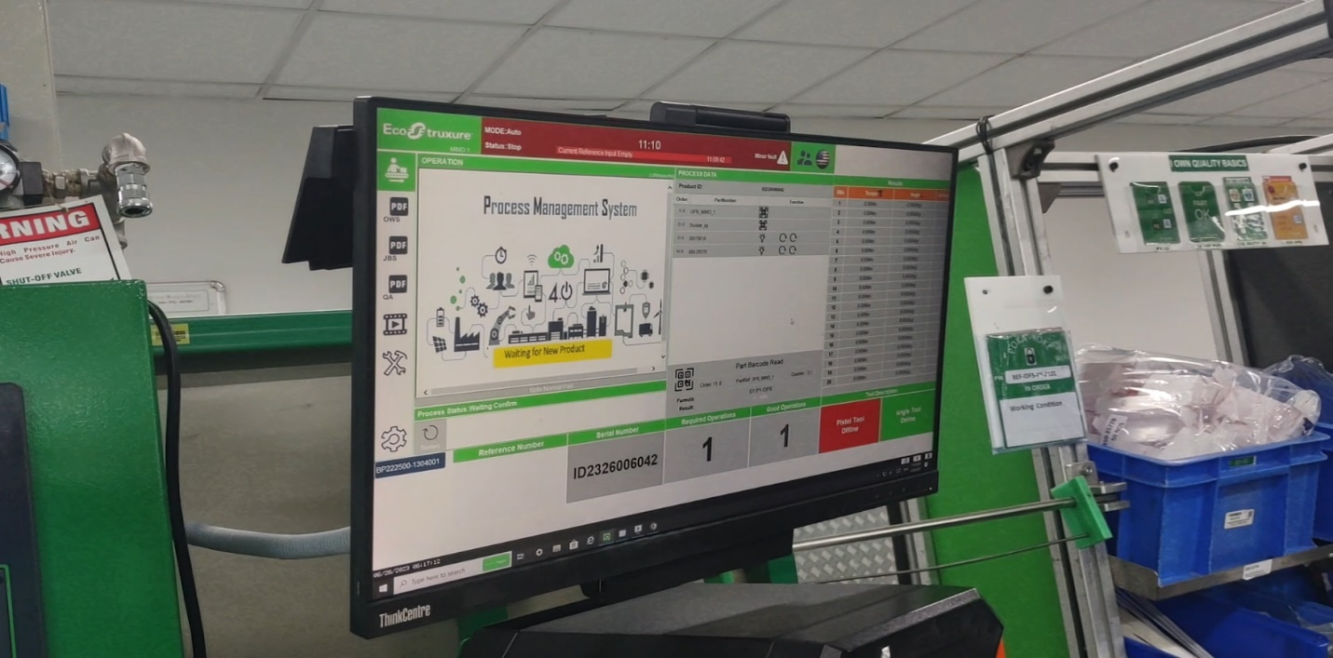

Slide 9
CASE STUDY - II
IISC BANGLORE SMART FACTORY
Smart Factory Platforms:
Legacy Platform: Includes legacy machines with sensors for KPI assessment.
Automated Platform: Incorporates advanced tech like 3D printers, CNC machines, robots, AGVs, all sensor-equipped.
Utilizes digital twin tech, NX CAD, TeamCenter PLM, ThingWorx MES, and Dimo Maint ERP for seamless integration and analysis.
Collaborative Initiatives with MSMEs:
IISc Bangalore's CEFC collaborates with MSMEs for Industry 4.0 adoption.
Smart solutions development: Automated inspection, PCB systems, resource bins, sensor dashboards.
Training programs: Enhancing skills in Industry 4.0 technologies.
Support for Industry 4.0 startups: Encouraging innovation and entrepreneurship.
Indigenous standards development: Contributing to Industry 4.0 standards and protocols.
Impact on MSMEs:
CEFC empowers MSMEs with technologies, solutions, training, and collaboration.
Enhances competitiveness, productivity, and sustainability.
Enables MSMEs to thrive in Industry 4.0 era.
Conclusion:
IISc Bangalore Smart Factory's CEFC supports India's industrial sector, particularly MSMEs, in Industry 4.0 adoption.
Cutting-edge technologies drive economic growth and innovation.
Smart manufacturing fosters transformative outcomes in India's manufacturing landscape.

Slide 10
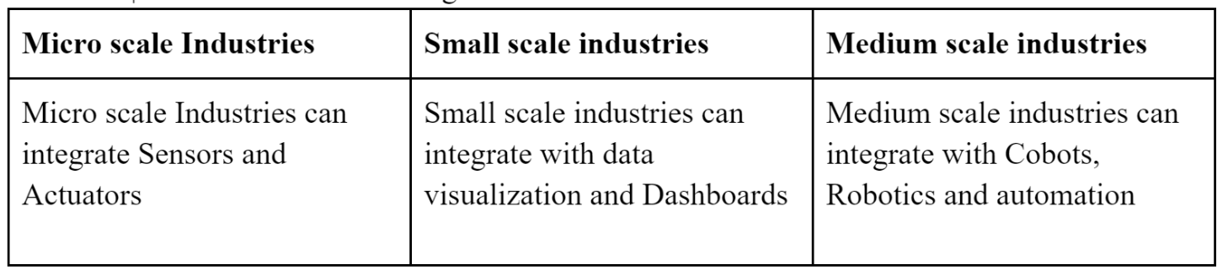
Step-by-step guide for MSMEs to plan and implement smart manufacturing
Roadmap for Transition from Legacy Industry to Smart Industry:
Assessment and Planning (3-6 Months):
Evaluate processes, infrastructure, skills.
Define objectives and implementation plan.
Pilot Implementation (6-12 Months):
Select pilot area or process.
Install sensors, implement analytics.
Evaluate and gather feedback.
Scaling Up (12-24 Months):
Expand to other areas, integrate systems.
Phased implementation, workforce training.
Full Implementation (24-36 Months):
Implement smart manufacturing across MSME.
Optimize, automate, and integrate processes.
Continuous Improvement (Ongoing):
Encourage innovation and process enhancement.
Stay updated with advancements.
Cybersecurity and Risk Management (Ongoing):
Regularly assess and update cybersecurity.
Mitigate risks through effective management.
Monitoring and Evaluation (Throughout):
Continuously monitor system performance.
Evaluate benefits: efficiency, quality, costs.

Slide 11
GOVERNTMENT SCHEMES FOR SUPPORTING SM IN MSME
Skill India:
Provides vocational training and skill development to enhance workforce employability.
Fosters acquisition of skills needed for smart manufacturing in MSMEs.
India Stack:
Offers open-source digital infrastructure with Aadhaar, UPI, and eSign components.
Facilitates seamless and secure digital interactions for smart manufacturing adoption.
Credit Guarantee Fund Trust for Micro and Small Enterprises (CGTMSE):
Aims to strengthen credit delivery system and flow of institutional credit to MSMEs.
Provides guarantee coverage for credit facilities extended by eligible banks to MSMEs.
Supports restructuring of stressed MSMEs through Sub-Debt support.
Government Initiatives and Support for MSMEs in Smart Manufacturing:
Ministry of Micro, Small and Medium Enterprises (MSME):
Technology and Quality Upgradation (TEQUP) Scheme:
Lean Manufacturing Competitiveness Scheme:
Digital MSME Scheme:
Marketing Assistance and Technology Upgradation:
Technology Upgradation and Quality Certification:
MSME Champions Scheme focuses on promoting competitiveness through Lean Manufacturing, ZED Scheme, and smart tech adoption.
ZED Certification promotes Zero Defect Zero Effect practices for high-quality, environmentally friendly products.
NASSCOM - Center of Excellence in IOT & AI: UDYAM 4.0 Smart Manufacturing Forum:
Supports manufacturing enterprises with annual turnover under Rs. 1,000 crores.
Aids in identifying digital solutions for manufacturing challenges.
Focuses on Industry 4.0 adoption and innovation.
Make in India:
Aims to create a favorable business environment for domestic manufacturing and technology adoption, including smart manufacturing.

Slide 12
ROI
Cost Analysis of Smart Manufacturing Implementation in MSMEs
Hardware:
Smart manufacturing hardware costs vary based on technologies used.
Example 1: Auto component manufacturer invests around 5 lakhs rupees
in new sensor-equipped machine tools.
Software:
Software costs vary based on functionality.
Example 2: Medical device maker allocates around 3 lakhs rupees for
a SCADA system.
Implementation Services:
Implementation services expenses include training, integration, and support.
Example 2: Furniture maker spends around 2 lakhs rupees on IT integration.
Ongoing Costs:
Ongoing costs involve data storage, maintenance, and upgrades.
Example 2: Plastics manufacturer sets aside around 1 lakh rupees/year for machine
maintenance.
Total Cost:
Smart manufacturing costs range from 10 lakhs to 50 lakhs rupees.
Example: Auto component SME with INR 30 million annual turnover invests:
Hardware and Equipment: INR 8 lakhs
Software and Data Analytics: INR 15 lakhs
Workforce Training: INR 4 lakhs
Infrastructure and Connectivity: INR 5 lakhs
Maintenance and Support (first year): INR 1 lakh

Slide 13
SUSTAINABILITY
Implementing Smart Manufacturing for benifitting MSMEs to achieve Sustainability
Resource Efficiency: Smart manufacturing optimizes resource use, reducing waste and energy consumption.
Waste Reduction: Real-time monitoring minimizes inefficiencies, decreasing waste generation.
Energy Conservation: IoT and automation manage energy use, cutting bills and emissions.
Product Lifecycle Management: Holistic tracking leads to circular economy principles, durability, and recyclability.
Carbon Footprint Reduction: Process optimization minimizes carbon emissions, aiding climate efforts.
Supply Chain Optimization: Enhanced coordination curbs waste and energy consumption in the supply chain.
Quality Enhancement: Real-time monitoring enhances product quality, extending lifetimes.
Skill Development: Training for smart manufacturing builds a skilled workforce and fosters long-term sustainability.
Regulatory Compliance: Accurate data from smart manufacturing aids regulatory adherence.
Innovation and Competitiveness: Smart manufacturing boosts competitiveness with sustainable practices, appealing to conscious consumers and investors.

Slide 14
CONCLUSION
Transformational Growth: Industry 4.0 and Smart Manufacturing offer transformative potential for MSMEs in India.
Global Competitiveness: Embracing these technologies is essential for MSMEs to stay competitive globally.
Benefits of Smart Manufacturing: Efficiency, cost reduction, waste minimization, and improved quality.
Data-Driven Insights: Industry 4.0 brings data-driven insights for informed decisions, personalized products, and optimized supply chains.
Challenges: Infrastructural limitations, skill gaps, and capital investment pose challenges.
Government Role: Policies, awareness campaigns, financial incentives, and skill development are crucial for successful implementation.

Slide 15
OUR EXPERIENCE

Slide 16
THANKYOU

